Slide 1
Module 1
17/05/2022

Slide 2
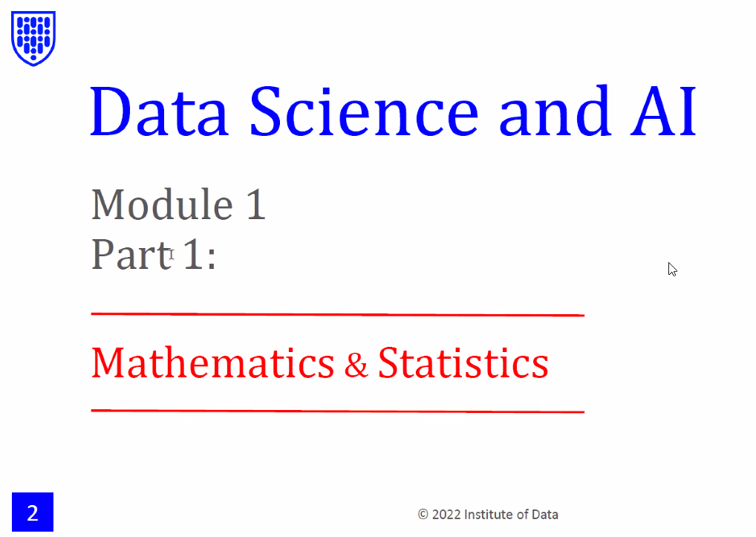

Slide 3
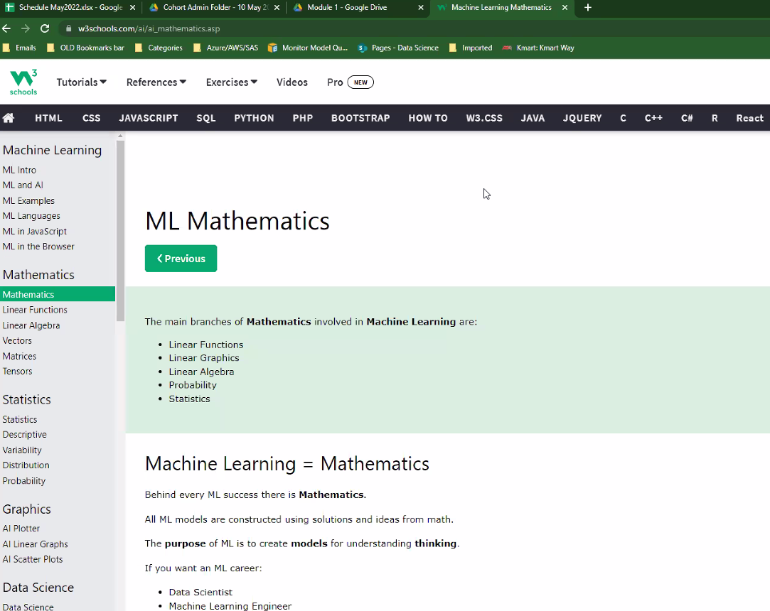

Slide 4
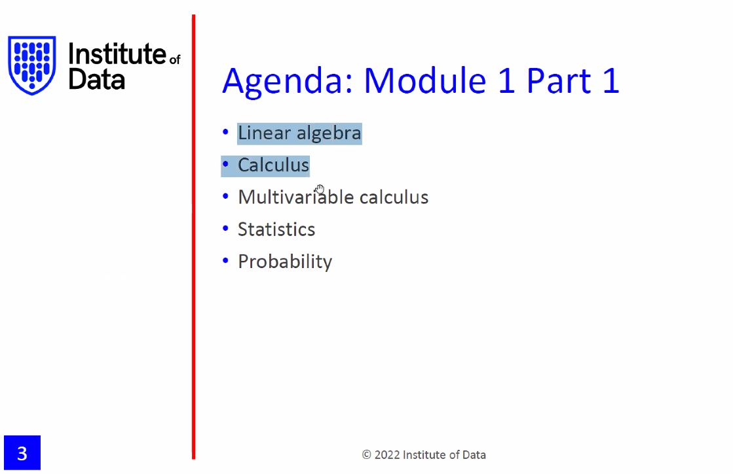
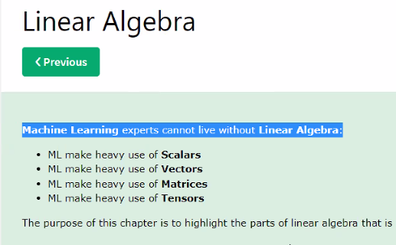
Very important to ML and AI, deep learning is based on this, how to save or calculate pictures on mathetics

Slide 5
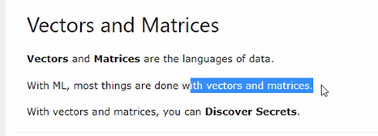
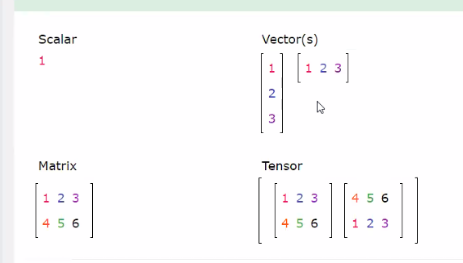
Scalar is A letter
Array, a sequence of scalar
Sequences of Vectors
Matrix is the way to save pictures
2 matrix
2 * 2*3
Sequence of matrix defines tensor
Dimension of matrix: 2*3
2 rows, 3 colums

Slide 6
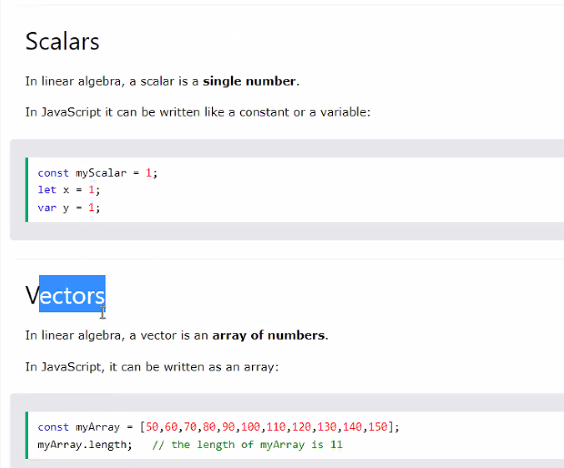
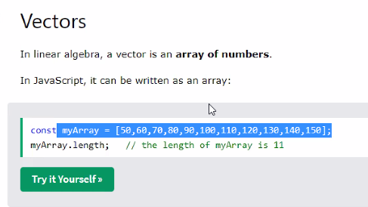

Slide 7
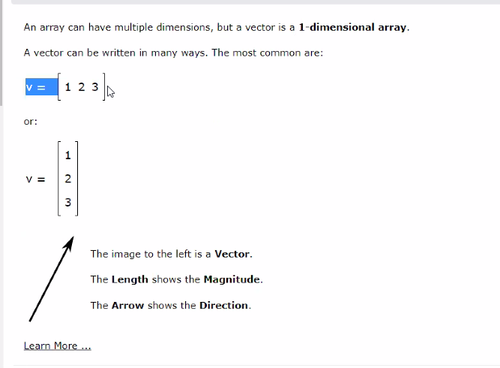
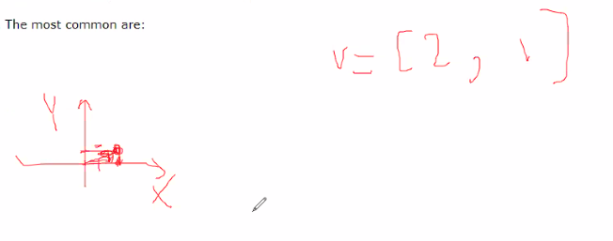
X=2, y=1

Slide 8
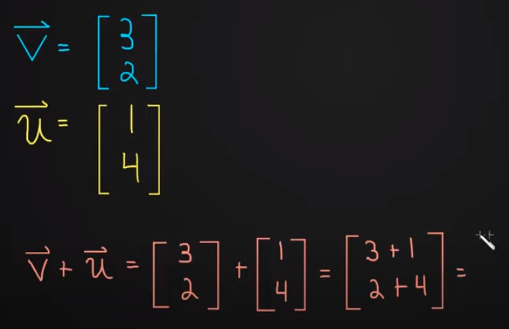

Slide 9
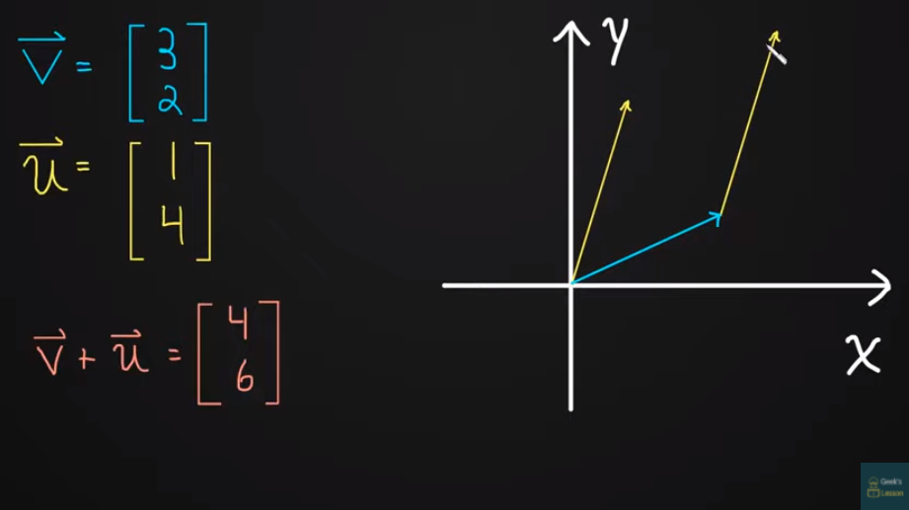

Slide 10
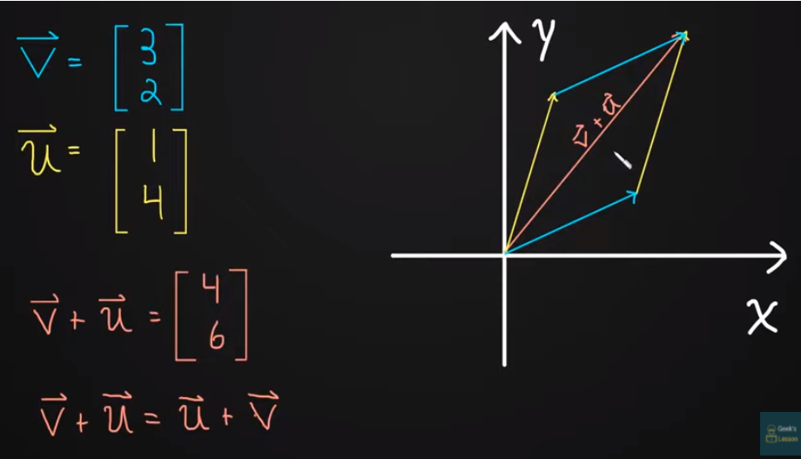

Slide 11
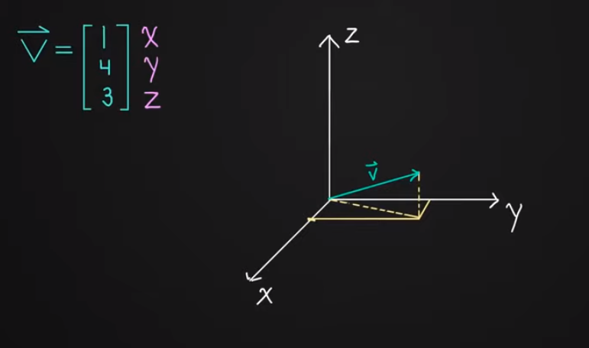

Slide 12
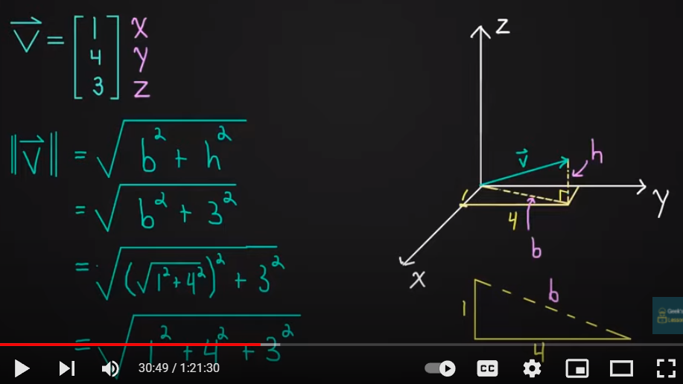

Slide 13
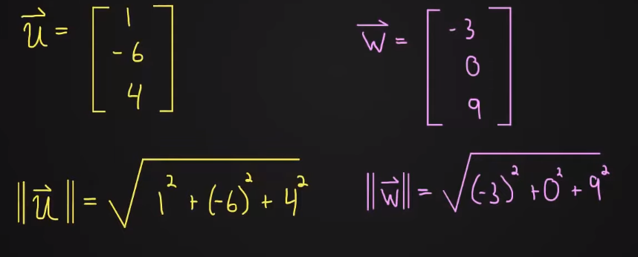

Slide 14
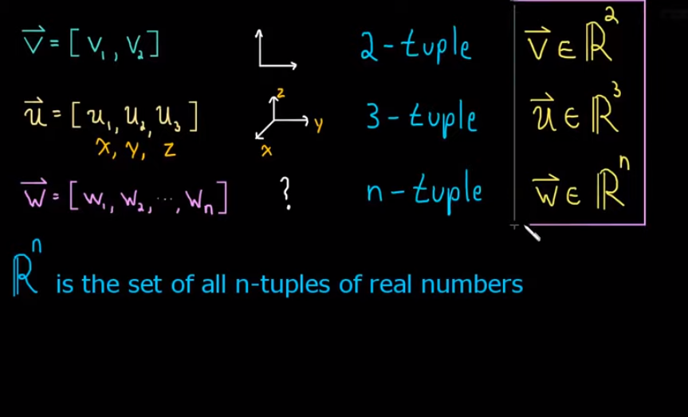
N is same as components, we say Rn has n components

Slide 15
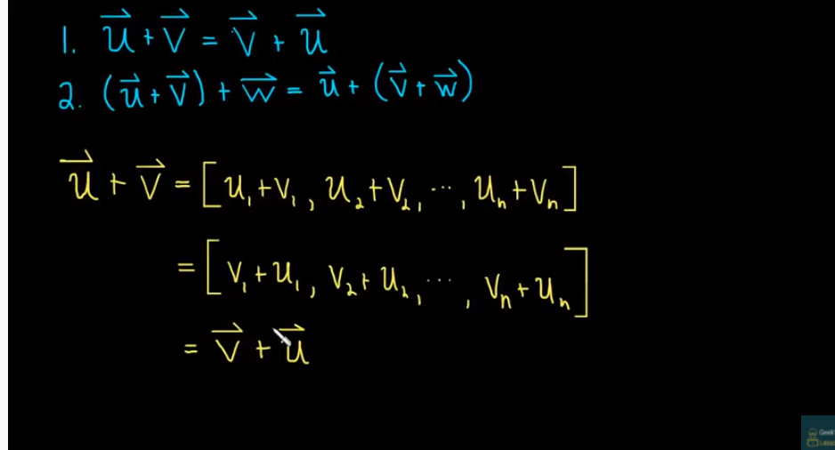

Slide 16
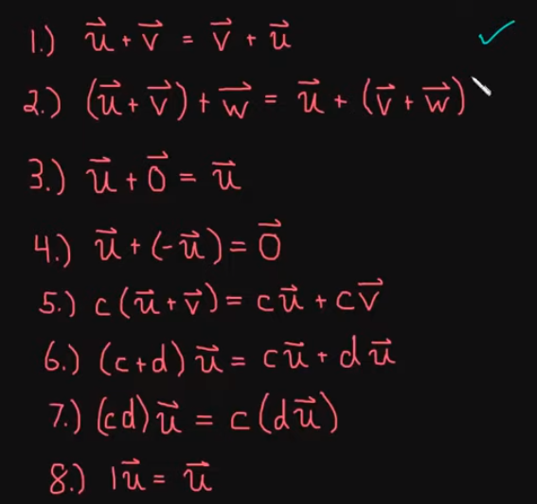
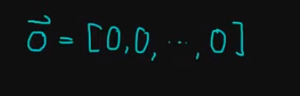

Slide 17
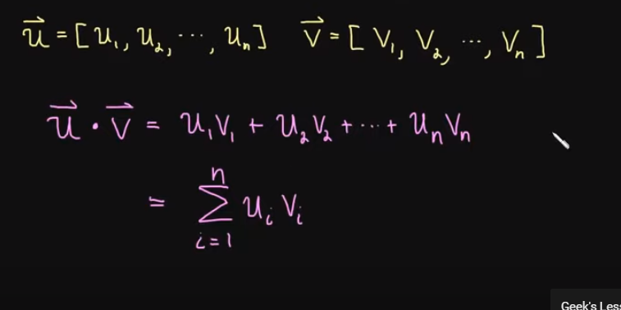

Slide 18
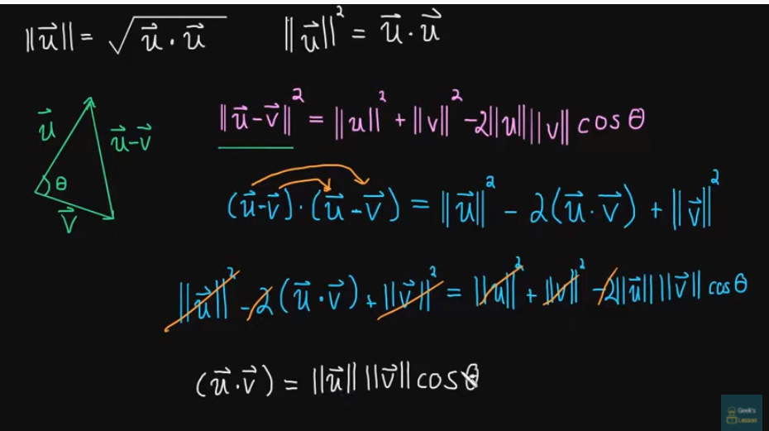

Slide 19
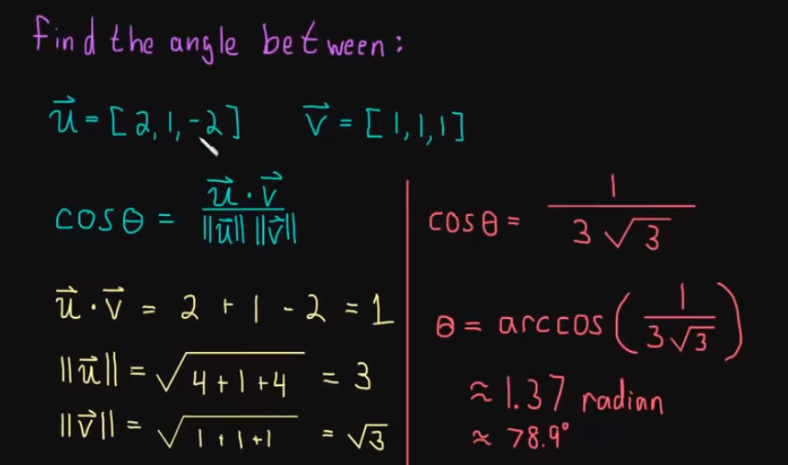

Slide 20
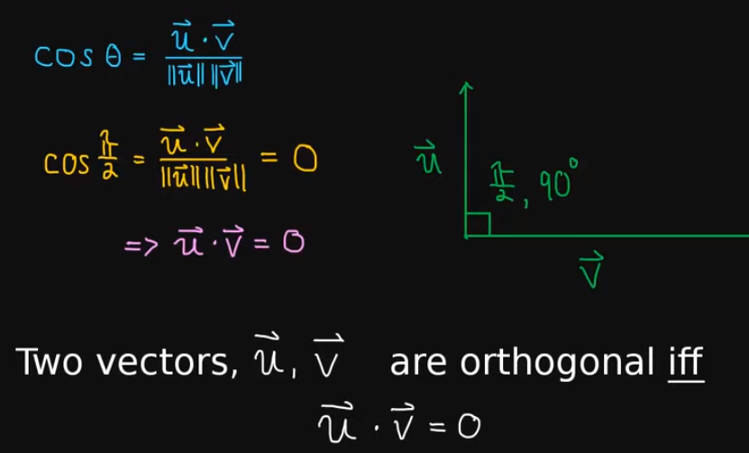

Slide 21
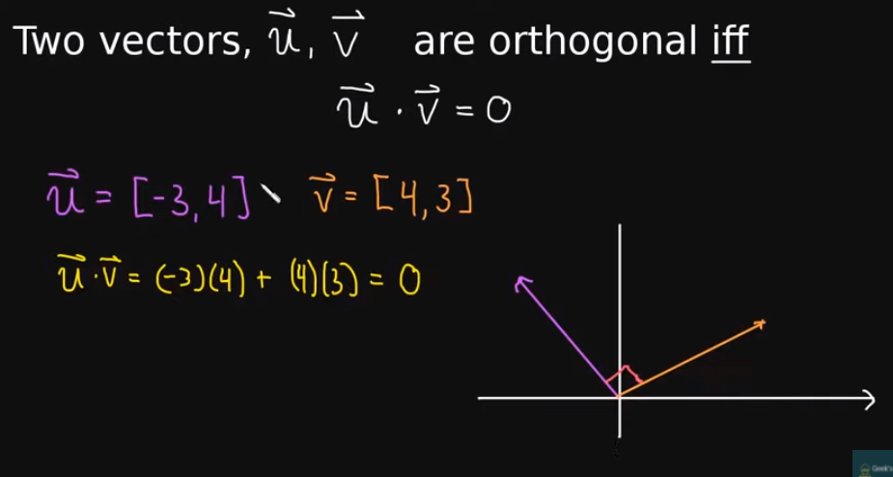

Slide 22
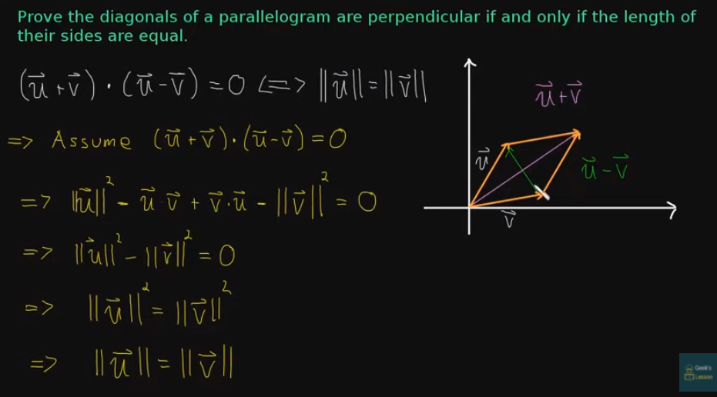

Slide 23
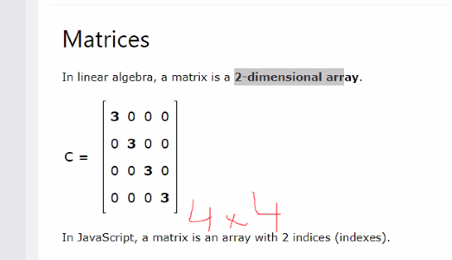
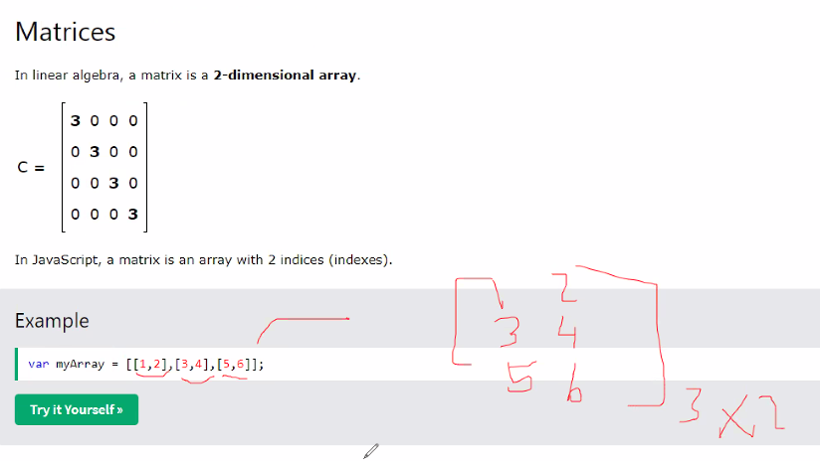

Slide 24
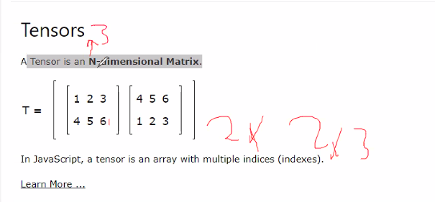
2 matrix, 2 rows * 3 columns, N-dimensional matrix, n=3

Slide 25
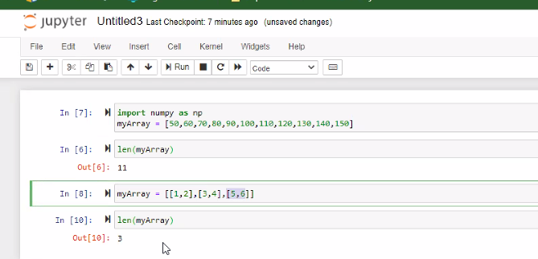
3 vector

Slide 26
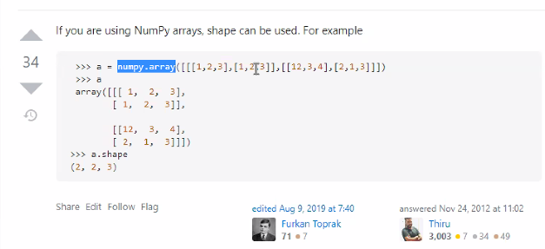

Slide 27
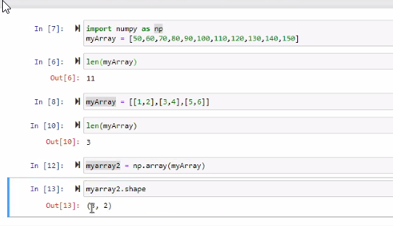

Slide 28
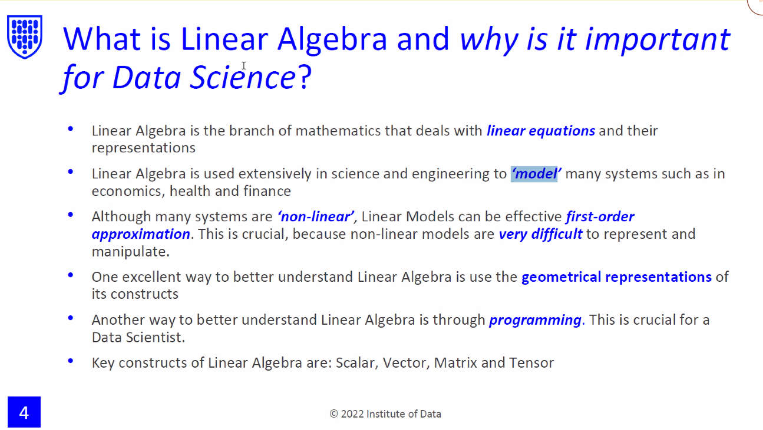

Slide 29
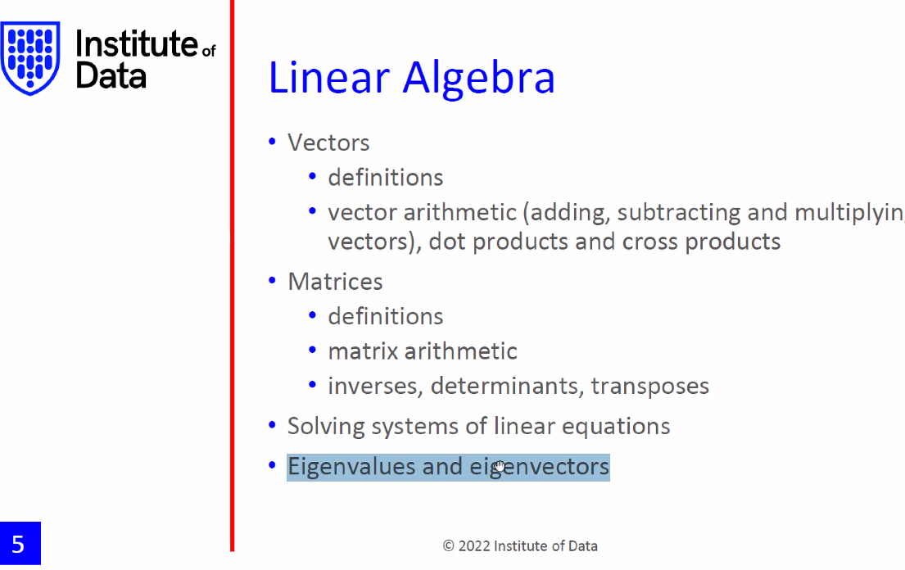
We need it for principal analysis, like we have one thousand columns, then we can get the best minimal columns

Slide 30
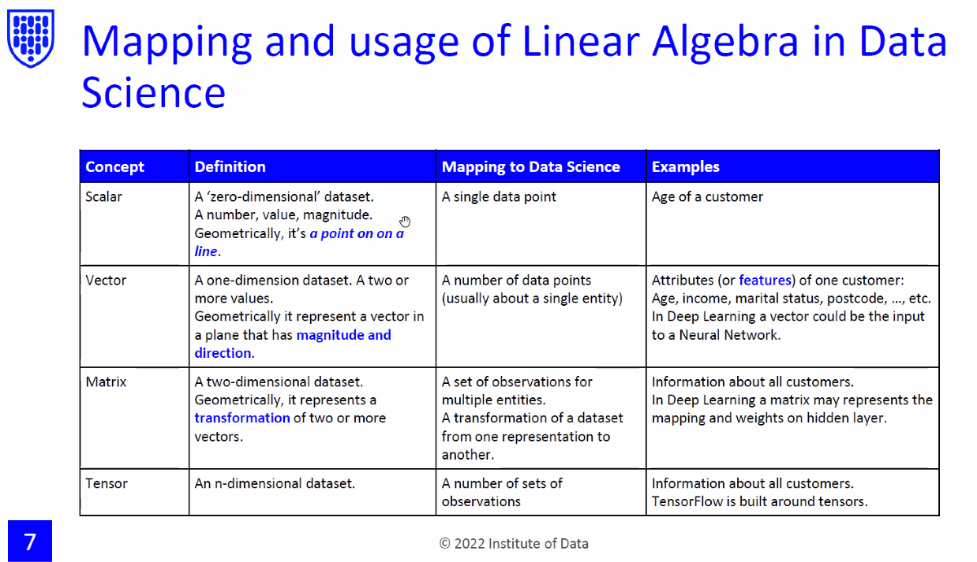
Coumns

Slide 31
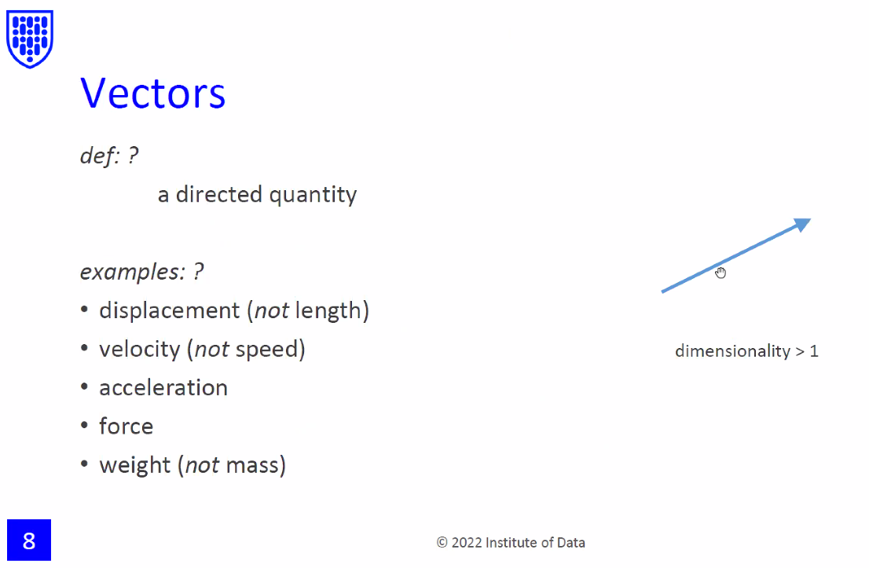

Slide 32
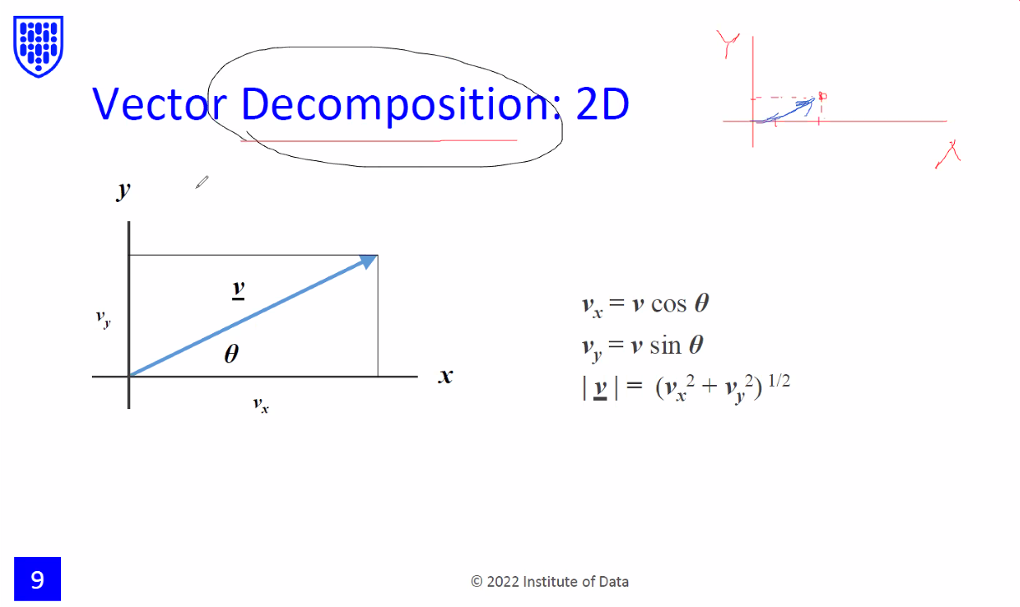
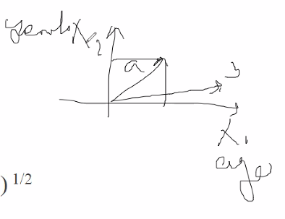

Slide 33
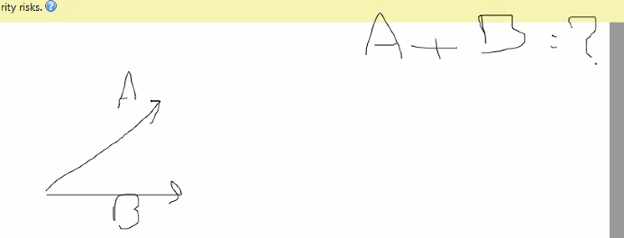
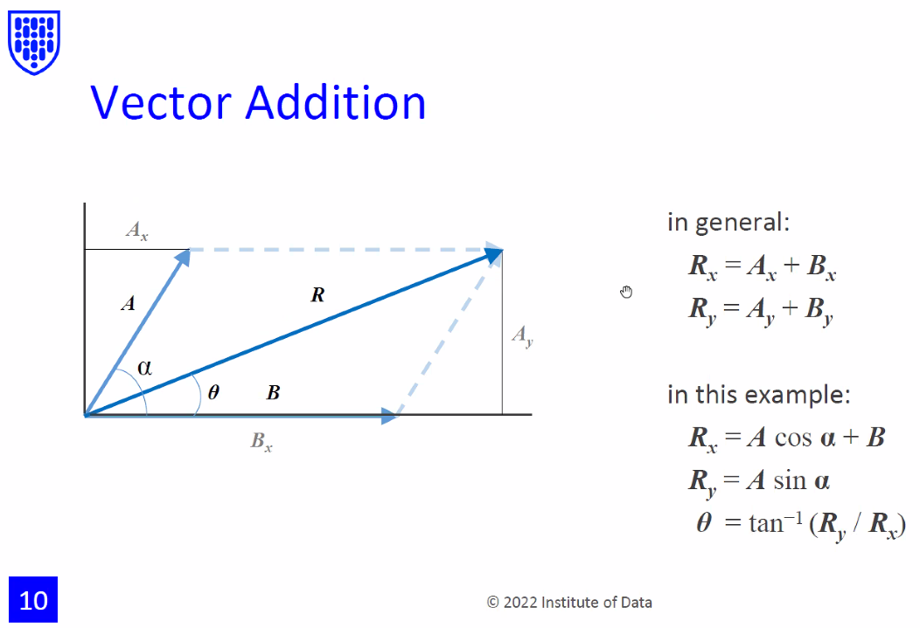
If we have a customer have A feature, we also have a customer have B, then if we meet somebody between A and B, it is potential Customer

Slide 34
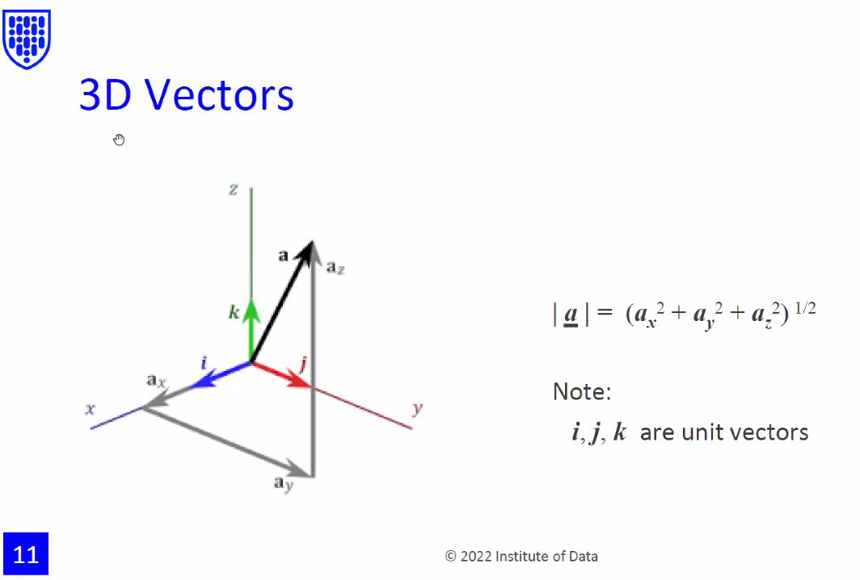
Dimensions are features, if we call 3D, we say we have 3 features, 3 columns

Slide 35
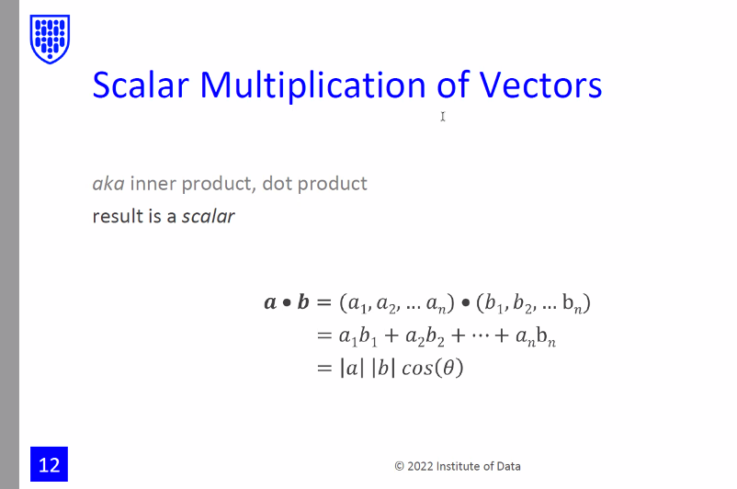
Not a vector

Slide 36
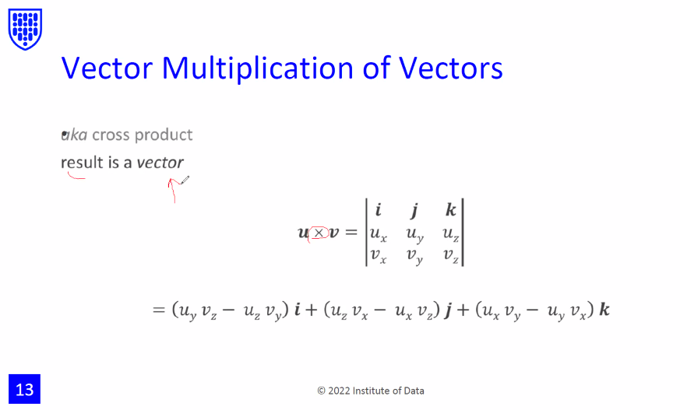
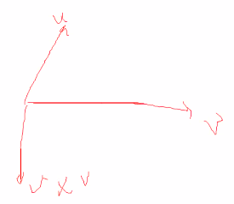

Slide 37
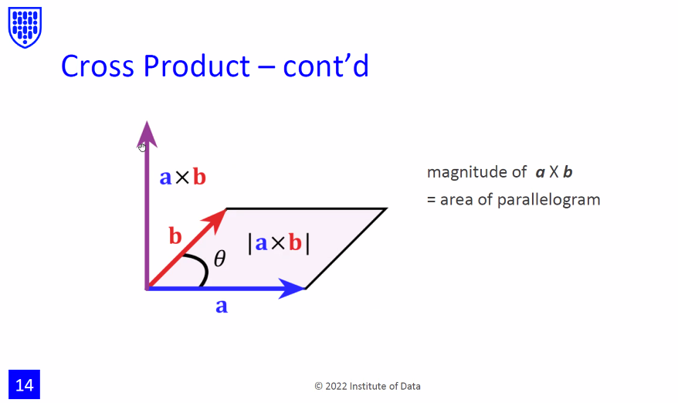

Slide 38
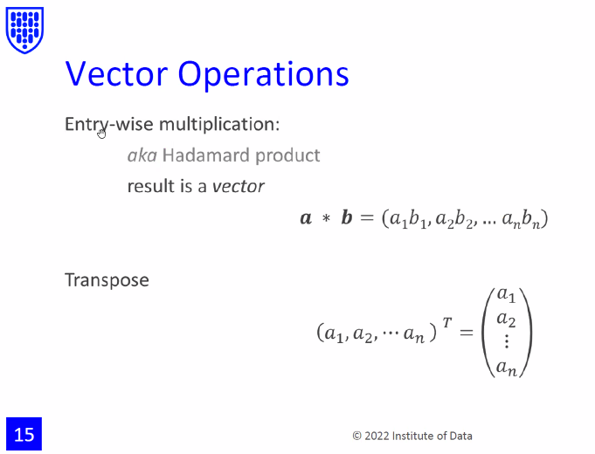
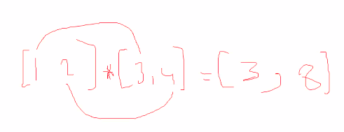
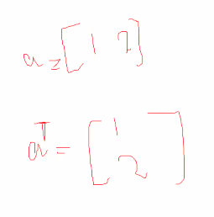
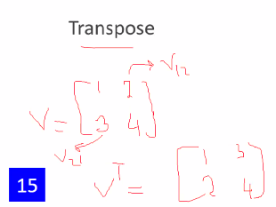



12 means row1, column2
21 means, row2, column1

Slide 39
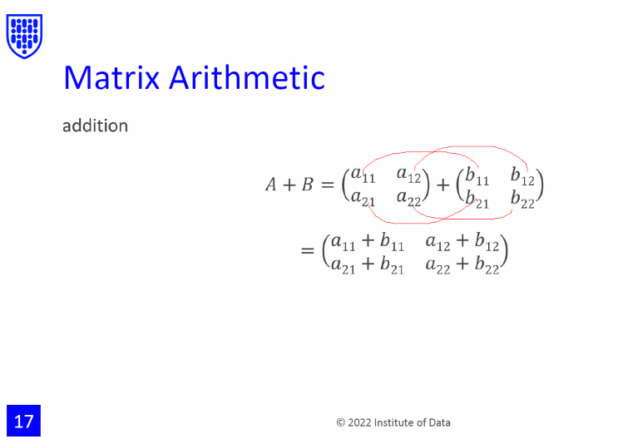

Slide 40


Slide 41

What is the benefit in ML of determinant of a Matrix
These operations are creating features
If the machine learning, so the result is not normal, perhaps the data is not normal, maybe because the value is too small compared with others,like house showing millions, but another one only have 0.1), we should transform every to normal for analysis

Slide 42

Any matrix multiply vectors, there is no difference.
What’s the benefit

Slide 43

Good solution for optimisation

Slide 44

Optimization is brought into it.
If condition 1 met,fit into b1
If condition2met, fit into b2
If condition3 is met, fit into b3
Trying to find x anywhere
My thinking, B is the sales, a is labour rate, x is the labour rate in each month?
N features of the customer, x is the new customer, can we make a model to see that customer is in what class

Slide 45

Coefficients A
(moduel 4)

Slide 46


Slide 47


Slide 48

Saturday lab

Slide 49


Slide 50


Slide 51


Slide 52


Slide 53


Slide 54


Slide 55


Slide 56


Slide 57


Slide 58


Slide 59


Slide 60


Slide 61


Slide 62


Slide 63

Look at P36-41, ask it on Saturday
Ask questions on Saturday sessions

Slide 64


